Slide 1

Microclimate Monitoring System- Soil Edition
-Alex Pilkey, David Kiszka, Jeremy Allen, Shakib Ahmed

Slide 2
Problem Statement
The New York State Department of Environmental Conservation (NYSDEC) needs a better understanding of the possible impact of global changes in the climate on microclimates within New York State so that appropriate plans may be developed to both take advantage of the positive effects and mitigate the adverse effects.

Slide 3
The Problem:
When an Event Occurs Somewhere in the World-
Generic Metric
Initial Condition
Seasonal/Short-Term Effects
Long-Term Effects
Currently, this initial condition data is missing, and the objective of this project is to contribute to building this baseline with soil condition data.

Slide 4
Inspiration
Diverse types of sensors can be chosen to build the monitoring device.
Some available sensors can collect soil and air temperature, pH levels, ground moisture, sunlight, and iron oxidations.
Most of these sensors are compatible with an Arduino device, with which the team was familiar due to prior experience.
Using a battery to power the monitoring device and overall system is feasible.
The LoRa-based communication system for transmission and receiving of data by the technician is also feasible.

Slide 5
Critical System Requirements
Environmental Sensing: The system will be collecting pH readings from a sensor placed in the ground.​
Collect Data: The pH readings will be collected four times per day. ​
Store Data: The data collected from the pH sensor will be stored on the devise until a technician retrieves it. ​
Deliver Data: The primary data collection method will be wireless via a command from the technician once they are within range.​
Receive Data : The technician will visit the site monthly to collect the data to their computer. ​
Analyze Data: The data that has been collected will be checked for corruption, compiled into a data file, and delivered to the NYSDEC. ​

Slide 6
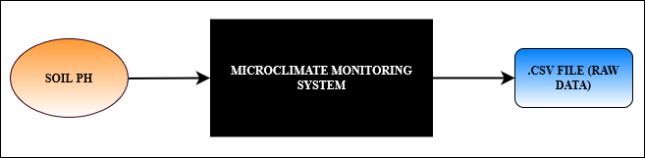
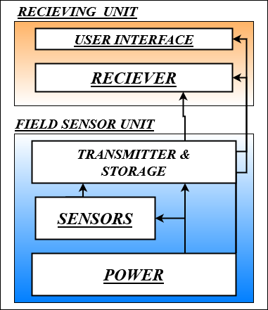
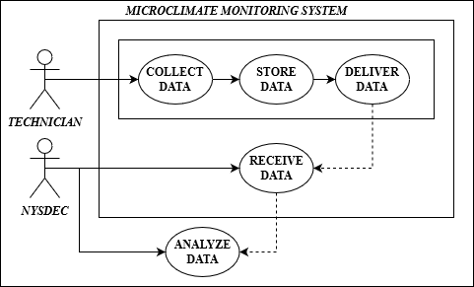
Diagrams & Designs
Black Box Diagram
Use Case Diagram
Logical Design

Slide 7
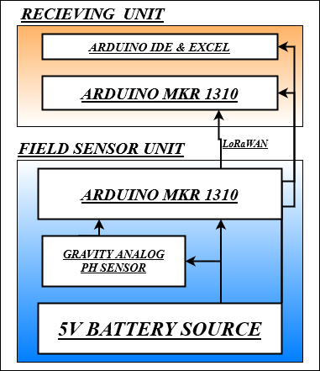
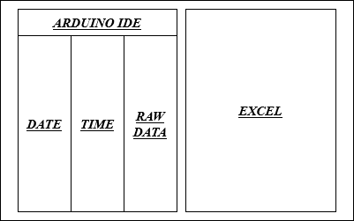
Diagrams & Designs
Wireframe Model
Physical Design

Slide 8

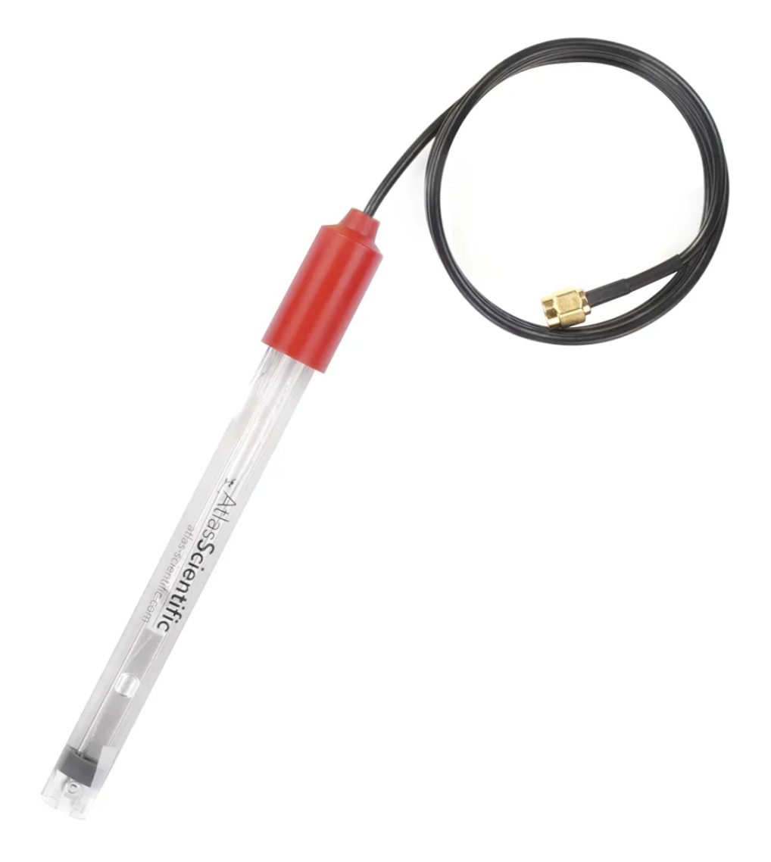
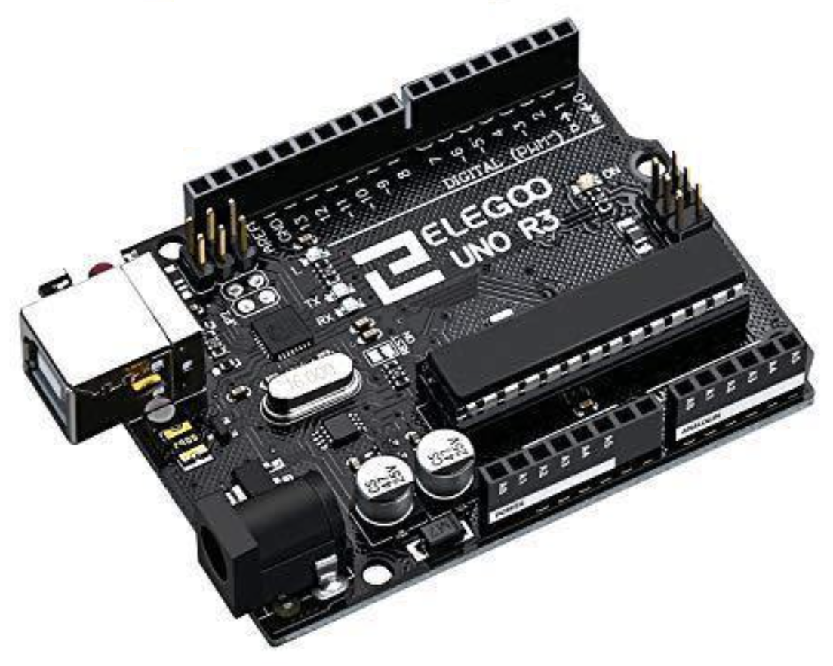
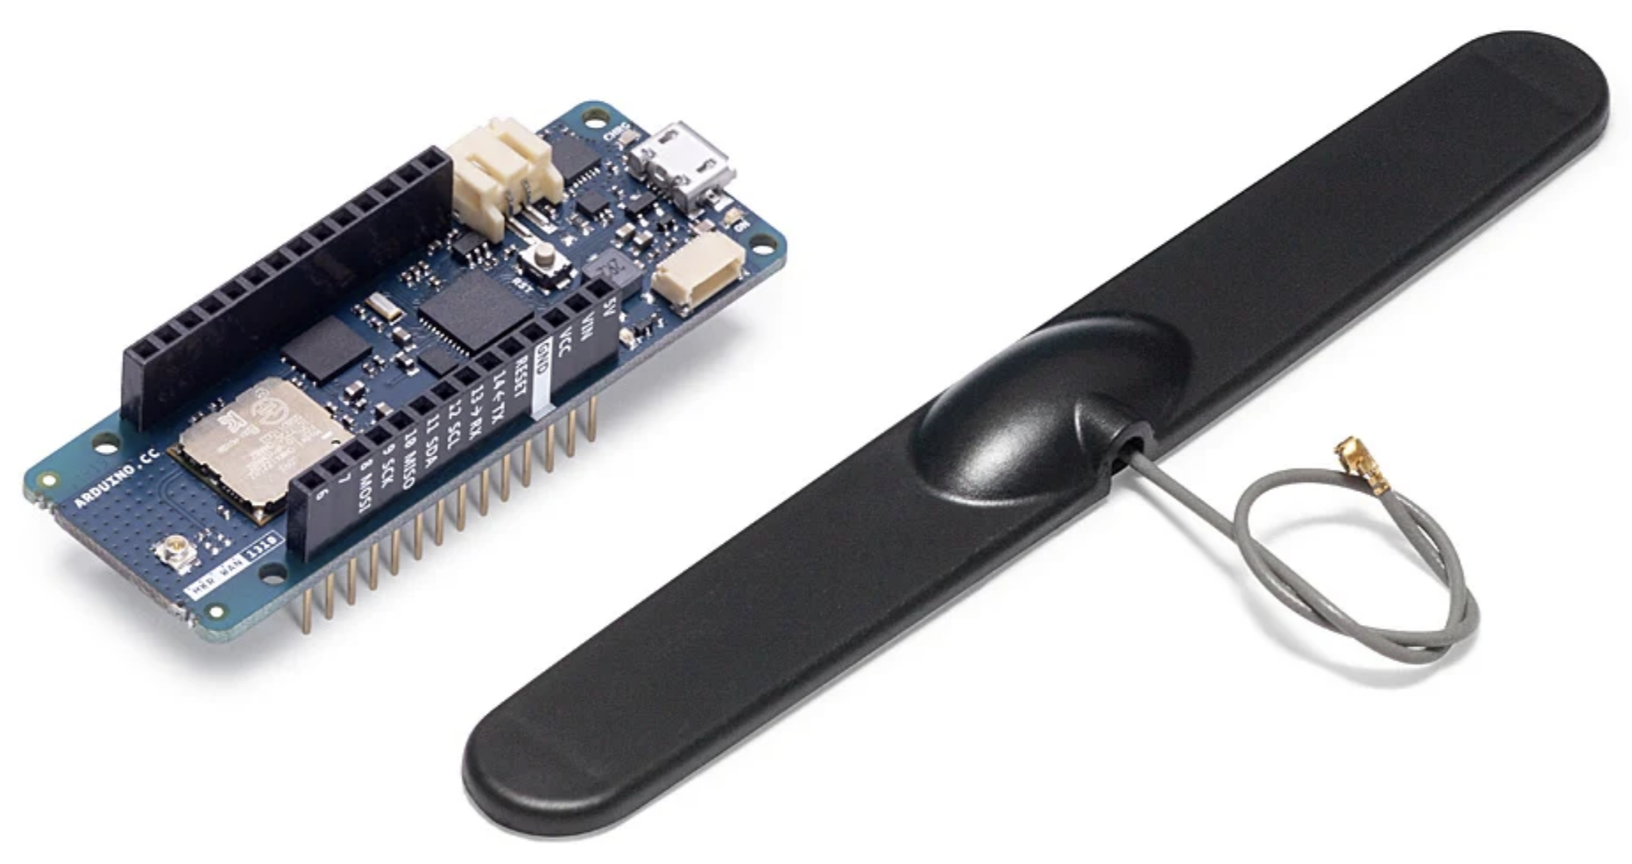


Data Flow
Field Sensor Unit :
pH Sensor
Processor
Transmitter/Receiver
Technician:
Activates the Unit & Creates a Data File on the Computer
Receiving Unit :
Arduino IDE
& Excel
Data File
NYSDEC:
Integrates Data into Climate Model and Makes It Public
Transmitter/Receiver

Slide 9
Key System Design
Arduino MKR 1310: Two devices are used - one in the field unit to store and transmit the data and the other connected to the technician’s computer to receive the data from the field unit.​
Arduino Uno R3: Device to control the field unit operations, including the sensor input. ​
Gravity Analog pH sensor: pH sensor designed to be placed into soil and send pH levels to transmission device. ​

Slide 10
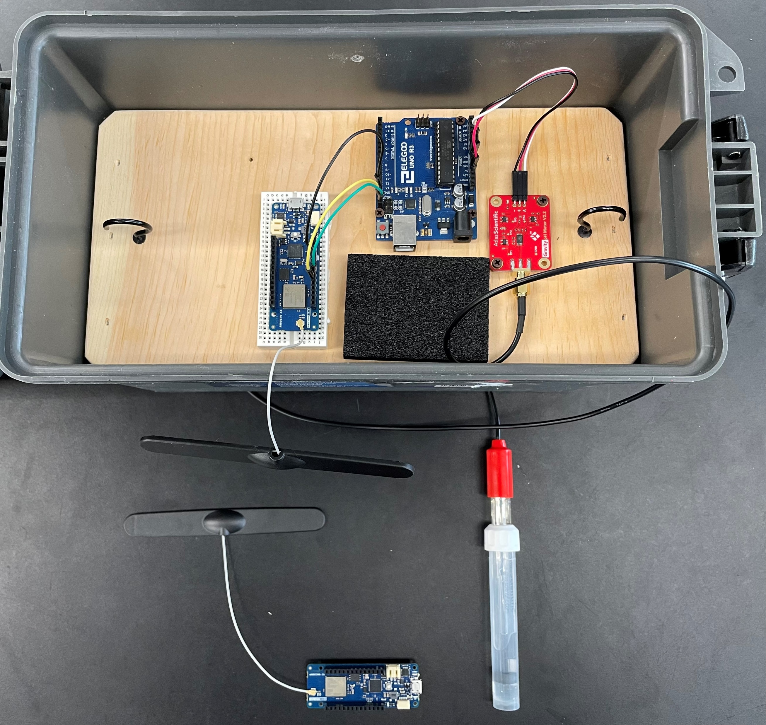
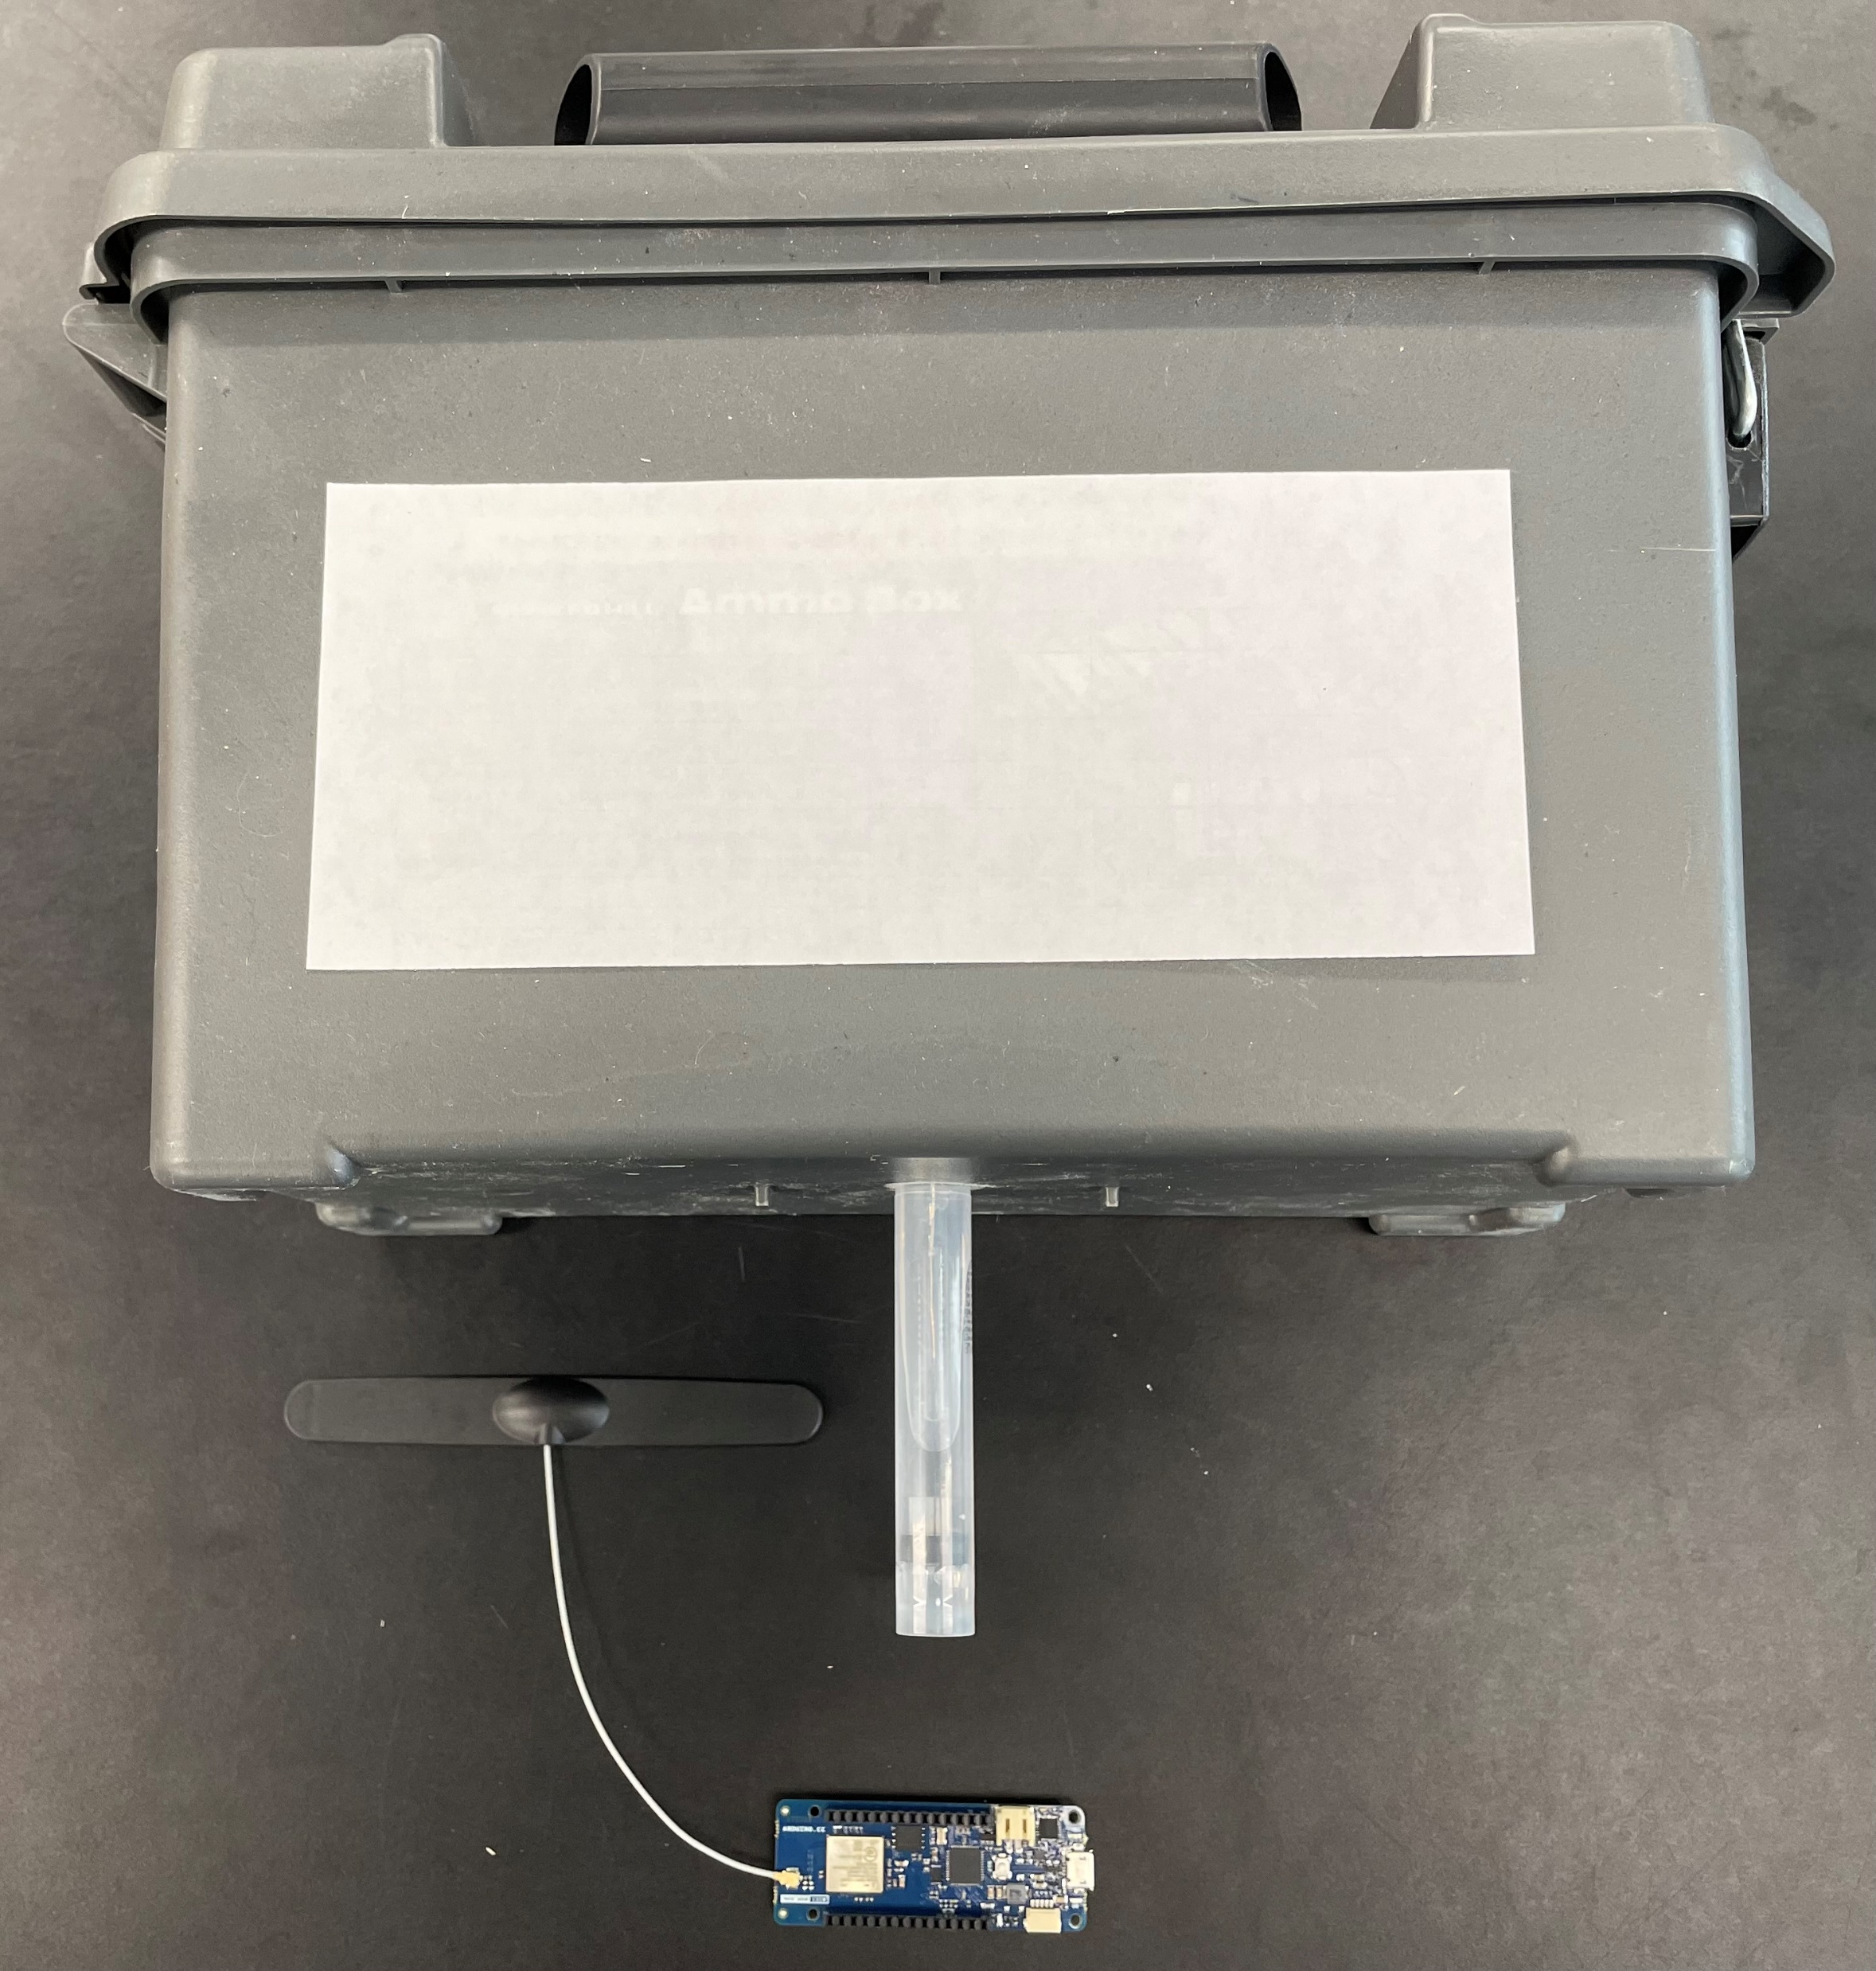
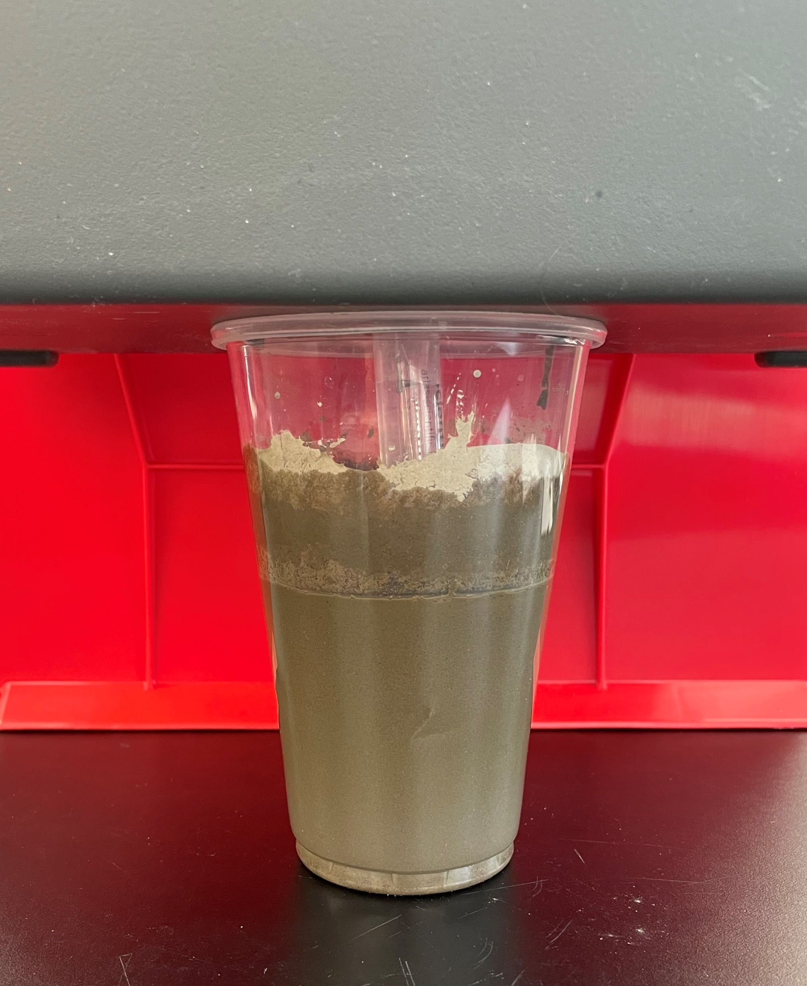
Prototype Implementation
The Implementation of the Field Sensor Unit (FSU) Prototype-

Slide 11
Prototype Implementation Analysis
The Sensor Proved to be quite responsive to changes in pH.
The processor could receive data and send it to the transmitter/receiver as well as run a control program with sleep modes.
The transmitter/receivers were able to communicate with each other as well as with a technician’s computer.
Pertinent graphs were able to be created using the Arduino IDE.

Slide 12
Advise For Future
Expand to the full LoRa network.
Be more cautious when powering and testing devices.
Focus on one sub-system or the whole system.
Power sub-system is crucial for powering and testing.
Using assumptions instead of focusing the power sub-system may lead to obstacles since different parts requires different amount of power.
Aim for a safety critical system.
Test parts individually if possible to check for malfunctions before assembling.
Try to have backups if possible.

Slide 13

Q & A

